Slide 1
Full Stack Application Development
Understanding the Basic Web application
Structure of web applications
Interaction between components
Akshaya Ganesan

Slide 2
Interaction between frontend and backend

Slide 3


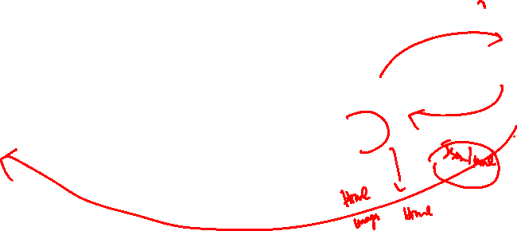
Working of the Web
Application Server
User enters the URL
HTTP Request
Web Server
Browser
xyz.com
HTTP Response
62.21.221.2
IP of xyz.com??
IP:62.21.221.2
DNS Server
Database

Slide 4
Working of the Web
In a traditional web application, HTTP requests are initiated by the user's interaction with the web interface.
The web server processes the request and returns an HTML page to the client.
During HTTP transport, the user cannot interact with the web application.
On receiving the response, the entire page is reloaded with the new code received.

Slide 5
AJAX
Asynchronous JavaScript and XML (Ajax) refer to a concept that is used to develop web applications in a better way.
Ajax defines a method of initiating client-to-server communication without page reloads.
It provides a way to enable partial page updates.
In an Ajax web application, the user is not interrupted in interactions with the web application.

Slide 6
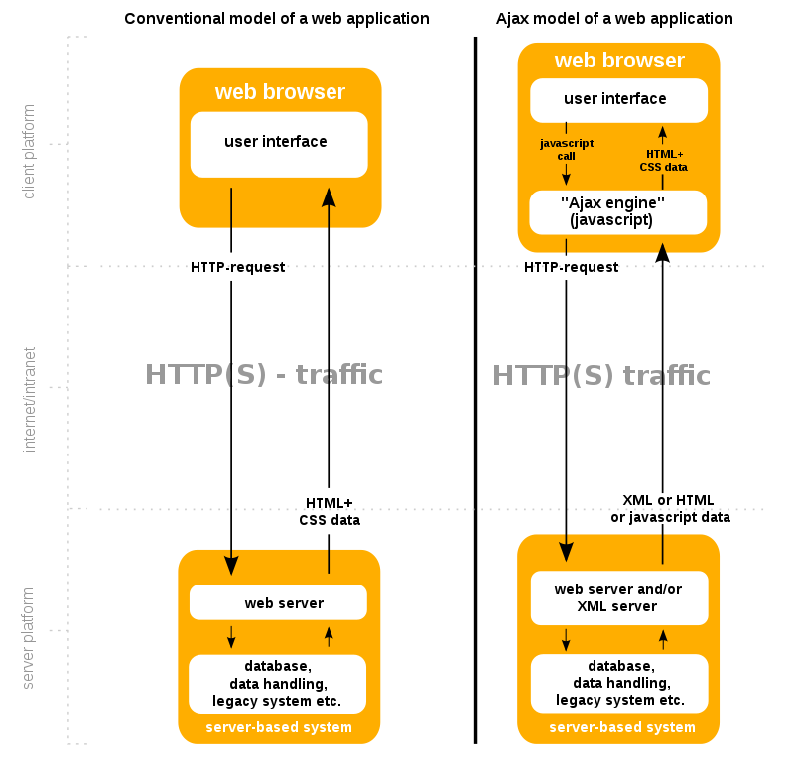
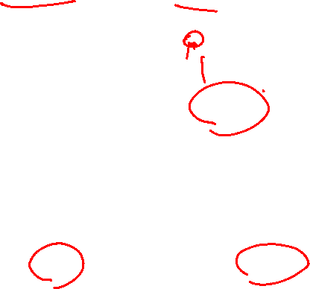
Model of a Web application
Image source: By DanielSHaischt, via Wikimedia Commons
https://commons.wikimedia.org/wiki/File%3AAjax-vergleich.svg, CC BY-SA 3.0,

Slide 7
Client-side rendering (CSR)
Client-side rendering (CSR) is a technique for rendering web content on the client-side, i.e., in the user’s browser.
With CSR, the client requests a minimal HTML file from the server containing the necessary JavaScript and CSS files.
When the client loads the JavaScript files, the JavaScript code is executed, which renders the content in the browser.

Slide 8
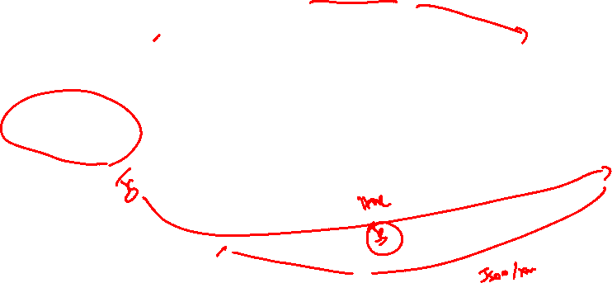
Client Side rendering
Application Server
HTTP Request
Browser(Client)
Presentation Logic
Web Server
xyz.com
HTTP Response
62.21.221.2
Database

Slide 9
Server-Side Rendering
Server-side rendering (SSR) is a technique for rendering web content on the server-side, i.e., before the page is sent to the client.
Server-Side Rendering is also named Pre-Rendering because the fetching of external data and transformation of components, content, and data into HTML happens before the result is sent to the client.
There are several benefits of using server-side rendering:
Better SEO.
Faster Initial Page Load.
Improved Accessibility.
Better Performance on Low-Powered Devices.

Slide 10

Server Side rendering
Application Server
HTTP Request
Browser(Client)
Web Server
xyz.com
HTTP Response
Presentation Logic
Database

Slide 11
Static Site Generation
Static Site Generation (SSG) is a popular approach to website development that involves generating a website’s content ahead of time and delivering it as static HTML files to end-users.
In SSG, the HTML is generated once, at build time.
The HTML is stored in a CDN or elsewhere and re-used for each request.
A static site generator combines the content and templates into a collection of static HTML files.
This process may also include optimizing images, minifying code, and generating metadata.

Slide 12



Static Site Generation
Some popular static site generators include Jekyll, Hugo, and Gatsby.
Benefits
Limitations
Performance
Not suitable for all types
SEO
No Real-time data
Cost

Slide 13
Interaction between components
AJAX
Client Side Rendering
Server Side Rendering
Static Site Generation

Slide 14
Thank You!

